Slide 1
BCI4ALS
Ophir Almagor and Sagi Furman
Mentor: Eti Gordon

Slide 2

About the mentor
Eti Gordon
Locked-in for several years
Eye-tracker communication
High-spirited and a fighter

Slide 3
System
MI-based BCI system
Hardware: USBamp by g.tec – 16 channels
Offline and online training
Communication keyboard

Slide 4
g.Tec hardware
Flexible electrode-adjustable hat
16 wet electrodes
USBamp amplifier
Connection to MATLAB through Simulink

Slide 5
The model
Tree bagger classification model
High variance data
Features
Relative power bands to resting-state
Relative power bands to other power bands
Three or four classes:
Right hand, left hand, Idle
Right hand, left hand, leg(s), Idle

Slide 6
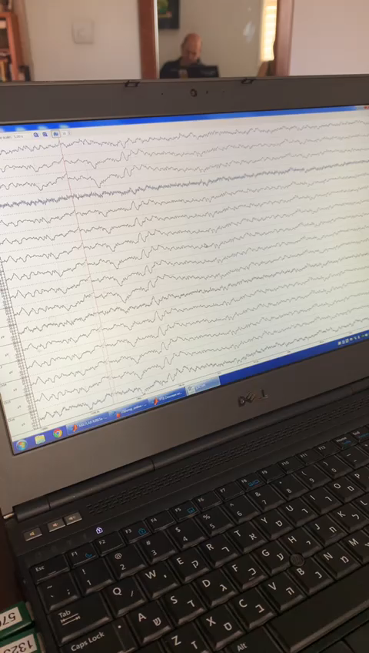
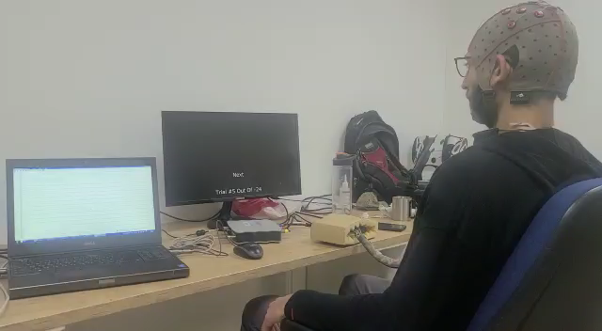
Training sessions
Mentor – online training
Sagi – online training

Slide 7
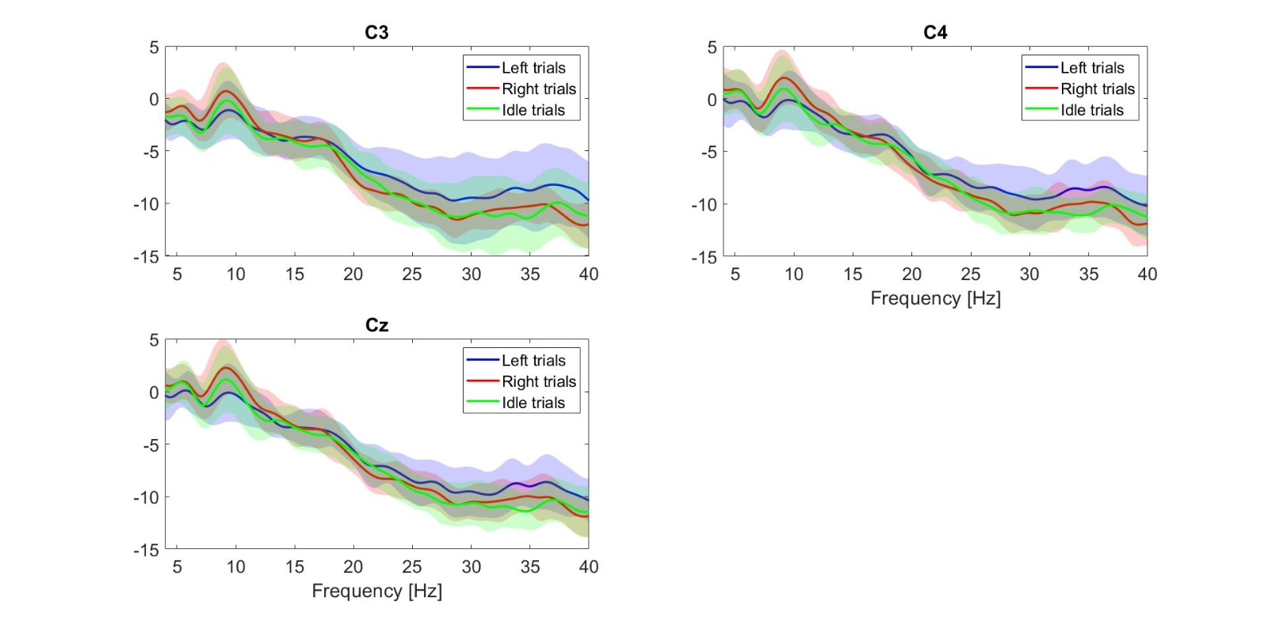
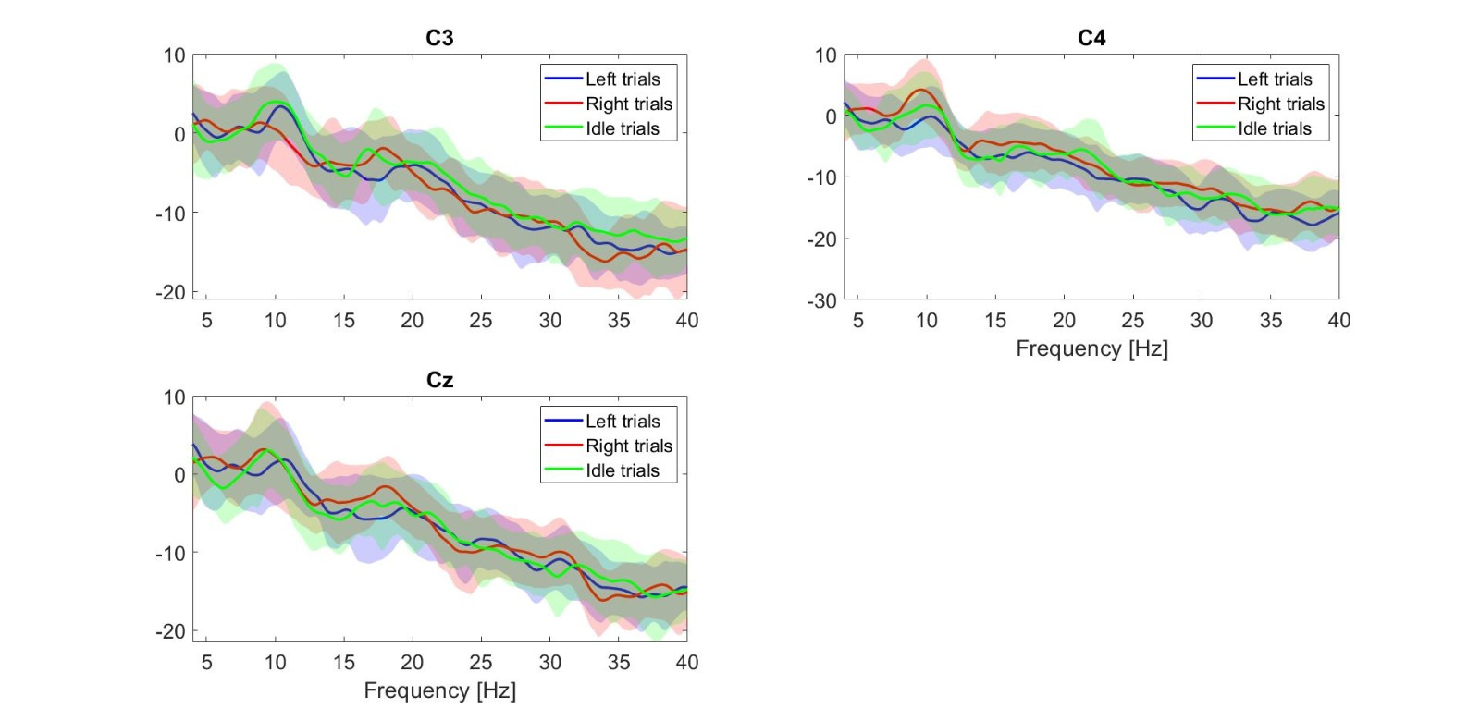
mentor
Best model – 54% accuracy
Results
Best model – 90% accuracy
Sagi furman

Slide 8
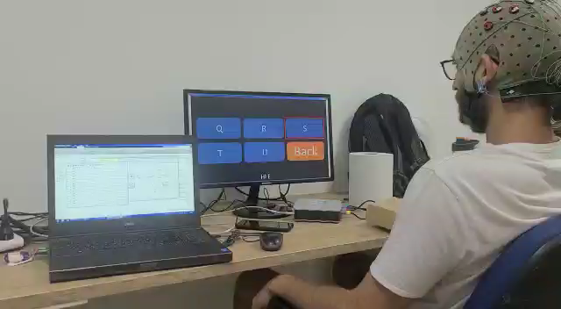
Communication
First communication

Slide 9
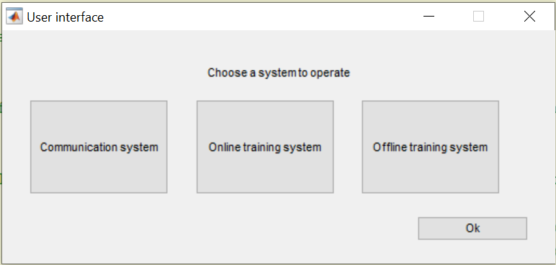
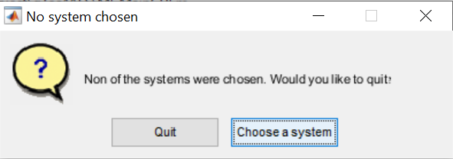
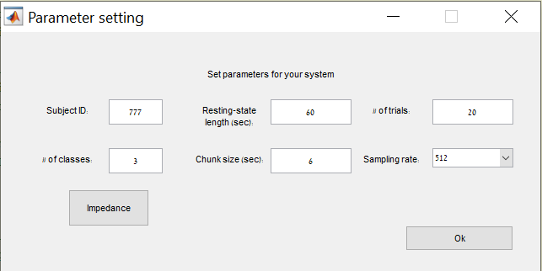
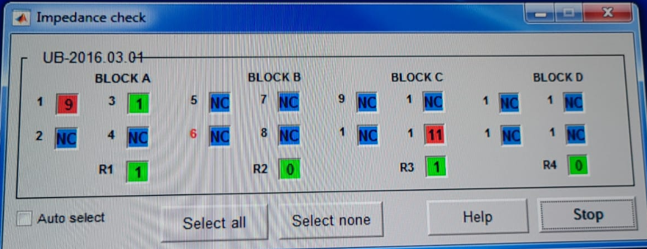
User interface
Mentor and assisting crew self operating the system for few weeks.

Slide 10

Thanks
Questions?
Comments?

